Slide 1
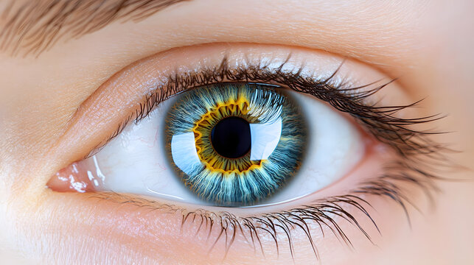
Enhancing Glaucoma Detection with Convolutional Neural Networks

Slide 2
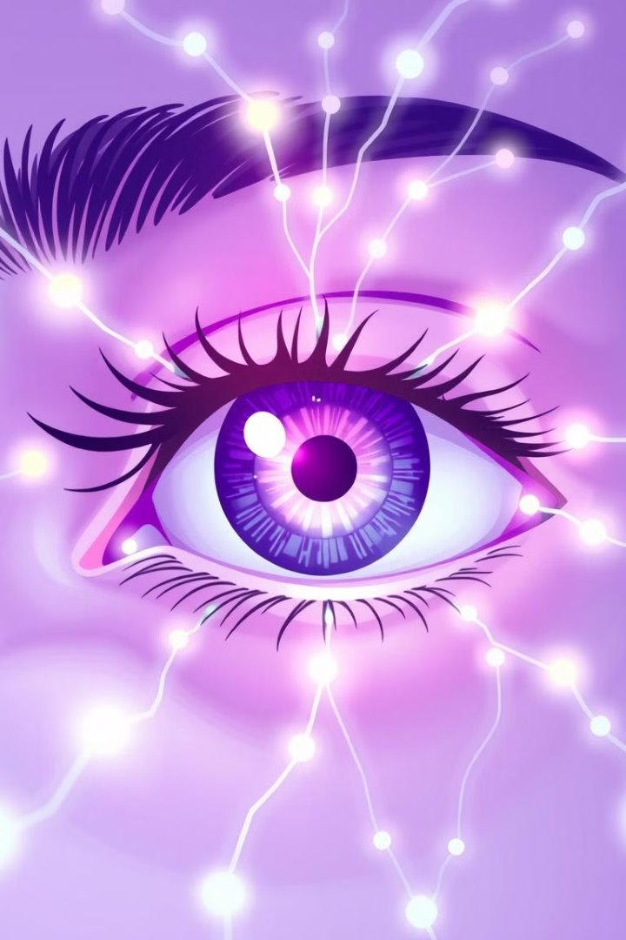
Enhancing Glaucoma Detection with Convolutional Neural Networks
Supervised by
Prof. Dr. Md. Asraf Ali
MD. SHOHANUR RAHMAN SHOHAN
FARJANA YESMIN OPI
MD. ABU TOWSIF
22-46013-1
22-47018-1
22-47019-1
A.F.M. RAFIUL HASSAN
22-47048-1

Slide 3
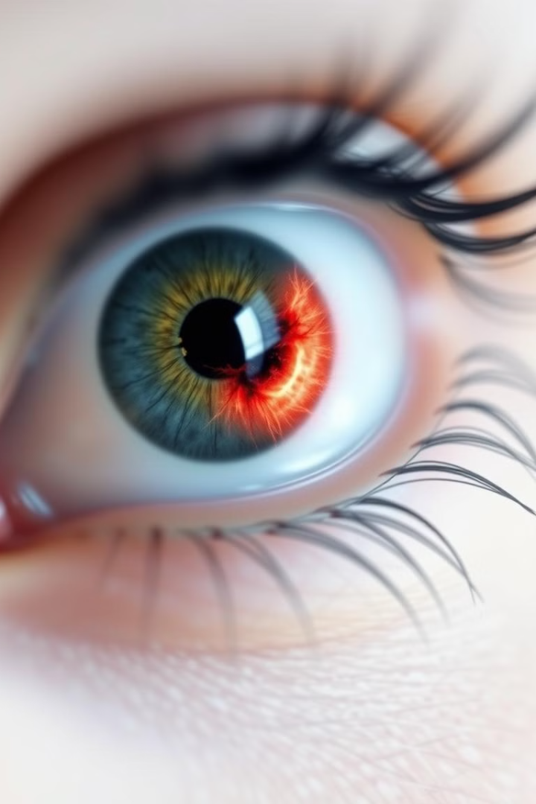
The Problem Statement
Importance of Vision
Eyes are vital for human interaction with the world.
Visual impairments severely affect quality of life.

Slide 4
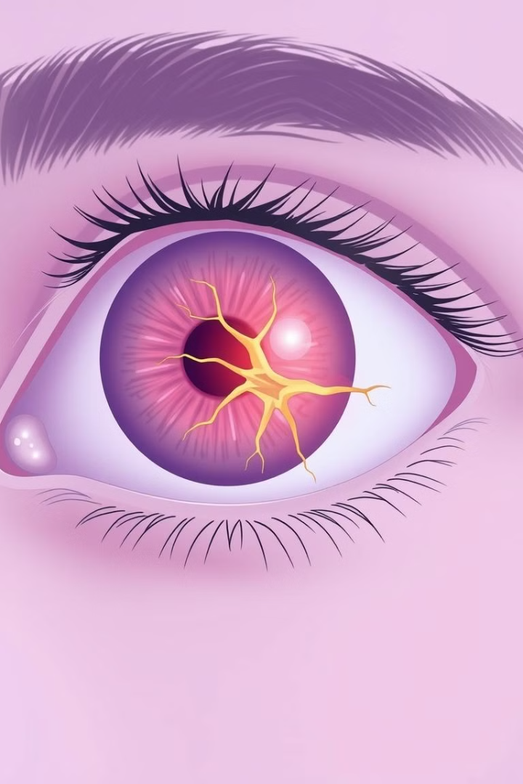
The Global Glaucoma Challenge
What is Glaucoma?
Why Focus on Detection?
A group of eye conditions that damage the optic nerve, often linked to increased eye pressure.
Early diagnosis is crucial to prevent vision loss. Traditional methods have limitations in cost, scalability, and accessibility.
Global Impact
76 million people affected by glaucoma (2020) with projections reaching 112 million by 2040.

Slide 5
Literature Review
Tham et al. (2014): Provide global prevalence and projections of glaucoma but do not explore AI-based solutions for early detection.
Cheng et al. (2013): Propose machine learning models using handcrafted features like cup-to-disc ratio but fail to address their limitations in generalizing to diverse datasets.
Weinreb et al. (2016): Discuss the importance of early glaucoma detection and management but overlook the potential
Traditional Approaches
Deep Learning Advances
Machine learning models like SVM and Decision Trees. Handcrafted features (e.g., cup-to-disc ratio). Limited generalizability across diverse datasets.
CNNs remove the need for manual feature extraction. Outperform traditional methods in medical image analysis.

Slide 6
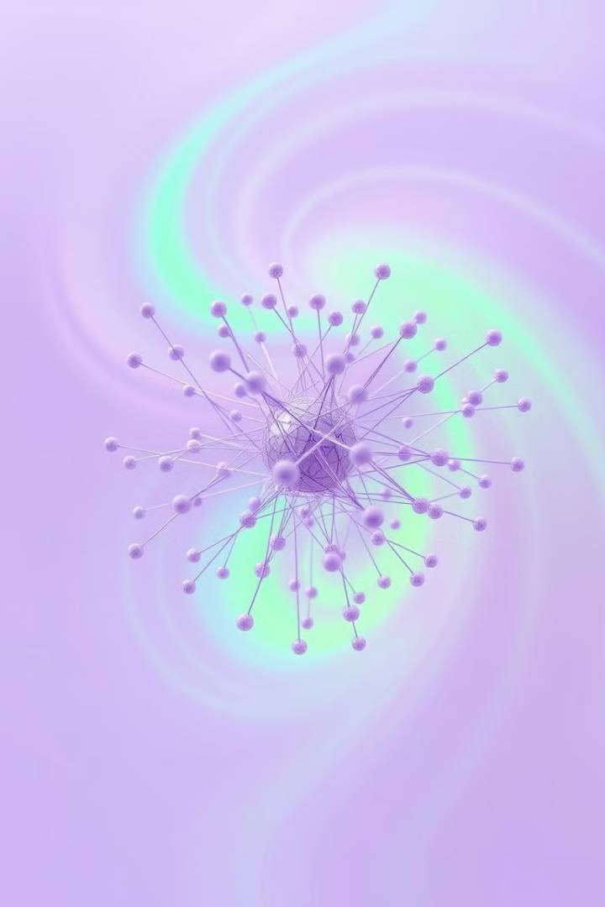
Change this pic
Our Mission: Smarter Glaucoma Detection
1
Objective
Develop a CNN-based framework for accurate and efficient glaucoma detection. Create a lightweight architecture optimized for mobile and edge devices.

Slide 7
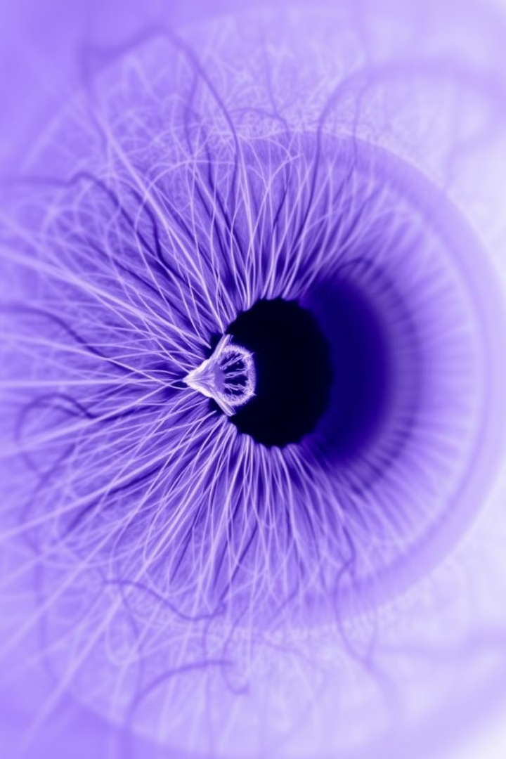
Dataset Overview
The Kaggle Glaucoma OCT Images Dataset was used, containing images categorized into normal and advanced glaucoma conditions..

Slide 8
Developing the Solution: A Systematic Approach
Data Collection
1
Source: Kaggle Glaucoma OCT Images Dataset. Images categorized into normal and advanced glaucoma conditions.
2
Preprocessing
Resize images to 224×224 pixels. Enhance features using noise reduction, edge detection, and sharpening. Normalize pixel values to [0, 1]. Encode labels for binary classification.
Model Development
3
Custom CNN with convolutional layers, pooling layers, dropout layers, fully connected layers, and a softmax output layer.
4
Training and Validation
Dataset split: 70% training, 30% validation (stratified sampling). Early stopping to avoid overfitting.
Evaluation
5
Metrics: Accuracy, precision, recall, F1-score, AUC-ROC. Confusion matrix for detailed analysis.

Slide 9
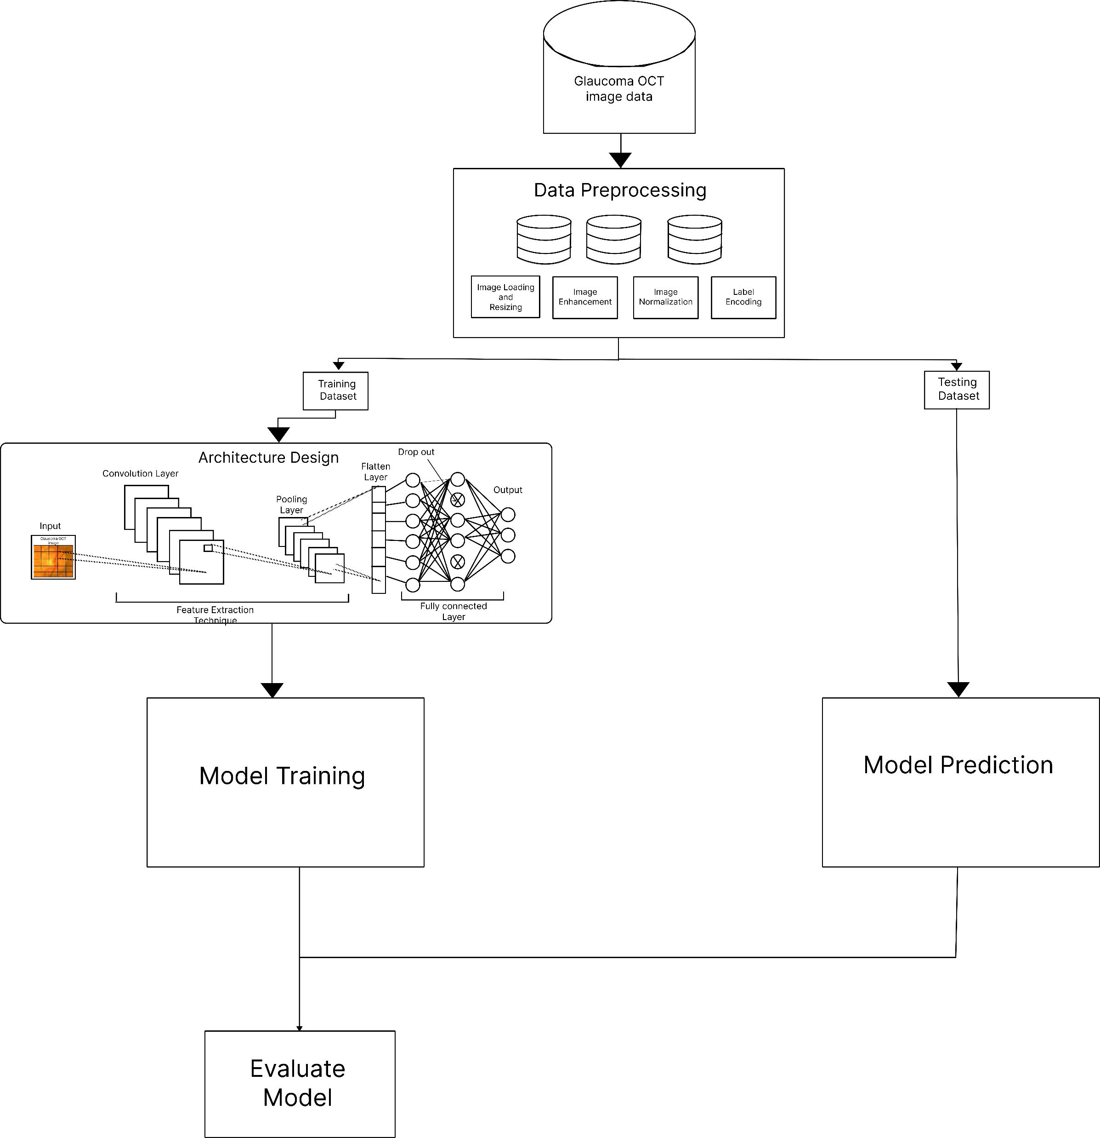
Architectural Workflow

Slide 10
Result
Accuracy
0.9717
F1-Score
0.9732
Precision
0.9561
Auc-Roc
0.9987
Recall
0.9909

Slide 11
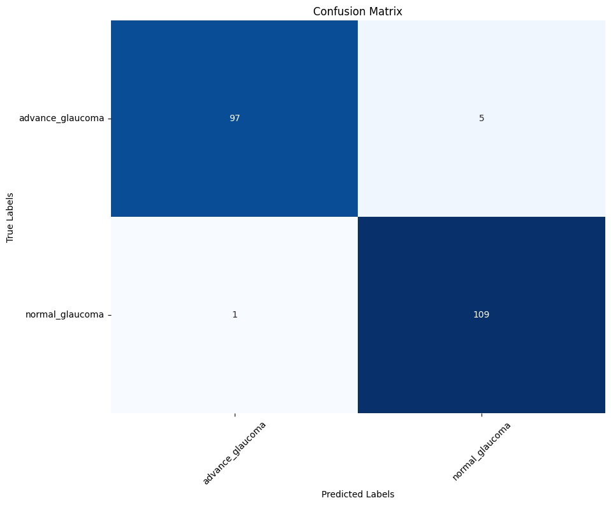
Result
Fig: Confusion Matrix

Slide 12
Key Takeaways & The Road Ahead
Main Findings
Classical machine learning models like SVMs and Decision Trees require extensive feature engineering and lack robustness across diverse datasets, limiting real-world applicability.
Confusion matrix highlights the model's robust classification with minimal misclassifications.
Deep learning approaches, especially CNNs, overcome manual feature extraction but face challenges like computational inefficiency, making them unsuitable for resource-constrained settings.
The findings underscore the potential for lightweight, efficient CNN architectures for real-time clinical use, especially in remote and underserved regions.
Our proposed model achieved excellent performance metrics for glaucoma detection:
Accuracy: 97.17%
Precision: 95.61%
Recall: 99.09%
F1-score: 97.32%
AUC-ROC: 99.87%

Slide 13
Key Takeaways & The Road Ahead
Future Scope
Expand dataset diversity to enhance robustness. Integrate explainability features to aid clinicians in understanding model predictions. Deploy the model on edge devices and validate in clinical settings. Explore other ophthalmic conditions using similar AI-driven approaches.

